Slide 1
Module 6
Introduction to databases

Slide 2
Contents
Objective:
Understand the need for a database
What a DBMS is and what problems it solves
The backend architecture of a web server and a DBMS
Topics:
Separating code from data
DBMS features
Backend architecture

Slide 3
When do we need to handle data?
Serving & Saving “content”
We need to use data to create HTML that fits a common structure:
Different article data to dynamically create HTML with a common structure (templating)
E-commerce sites have a common product page with different data
The data is just content that needs to be served to the user.
Eg: Files, videos, images, pdf
We might want to store information that is sent via client requests that is important for processing later on
Eg: username/password or delivery address in an e-commerce experience
Client requests might submit files (like audio/video)

Slide 4
Separating code from data
Analyse a few examples, and see what bits of the application we would put in code and what bits we classify as data
Flipkart
Gmail
Facebook

Slide 5
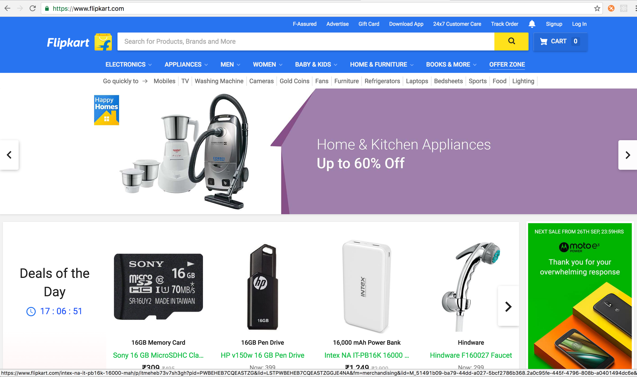
Separating code from data

Slide 6
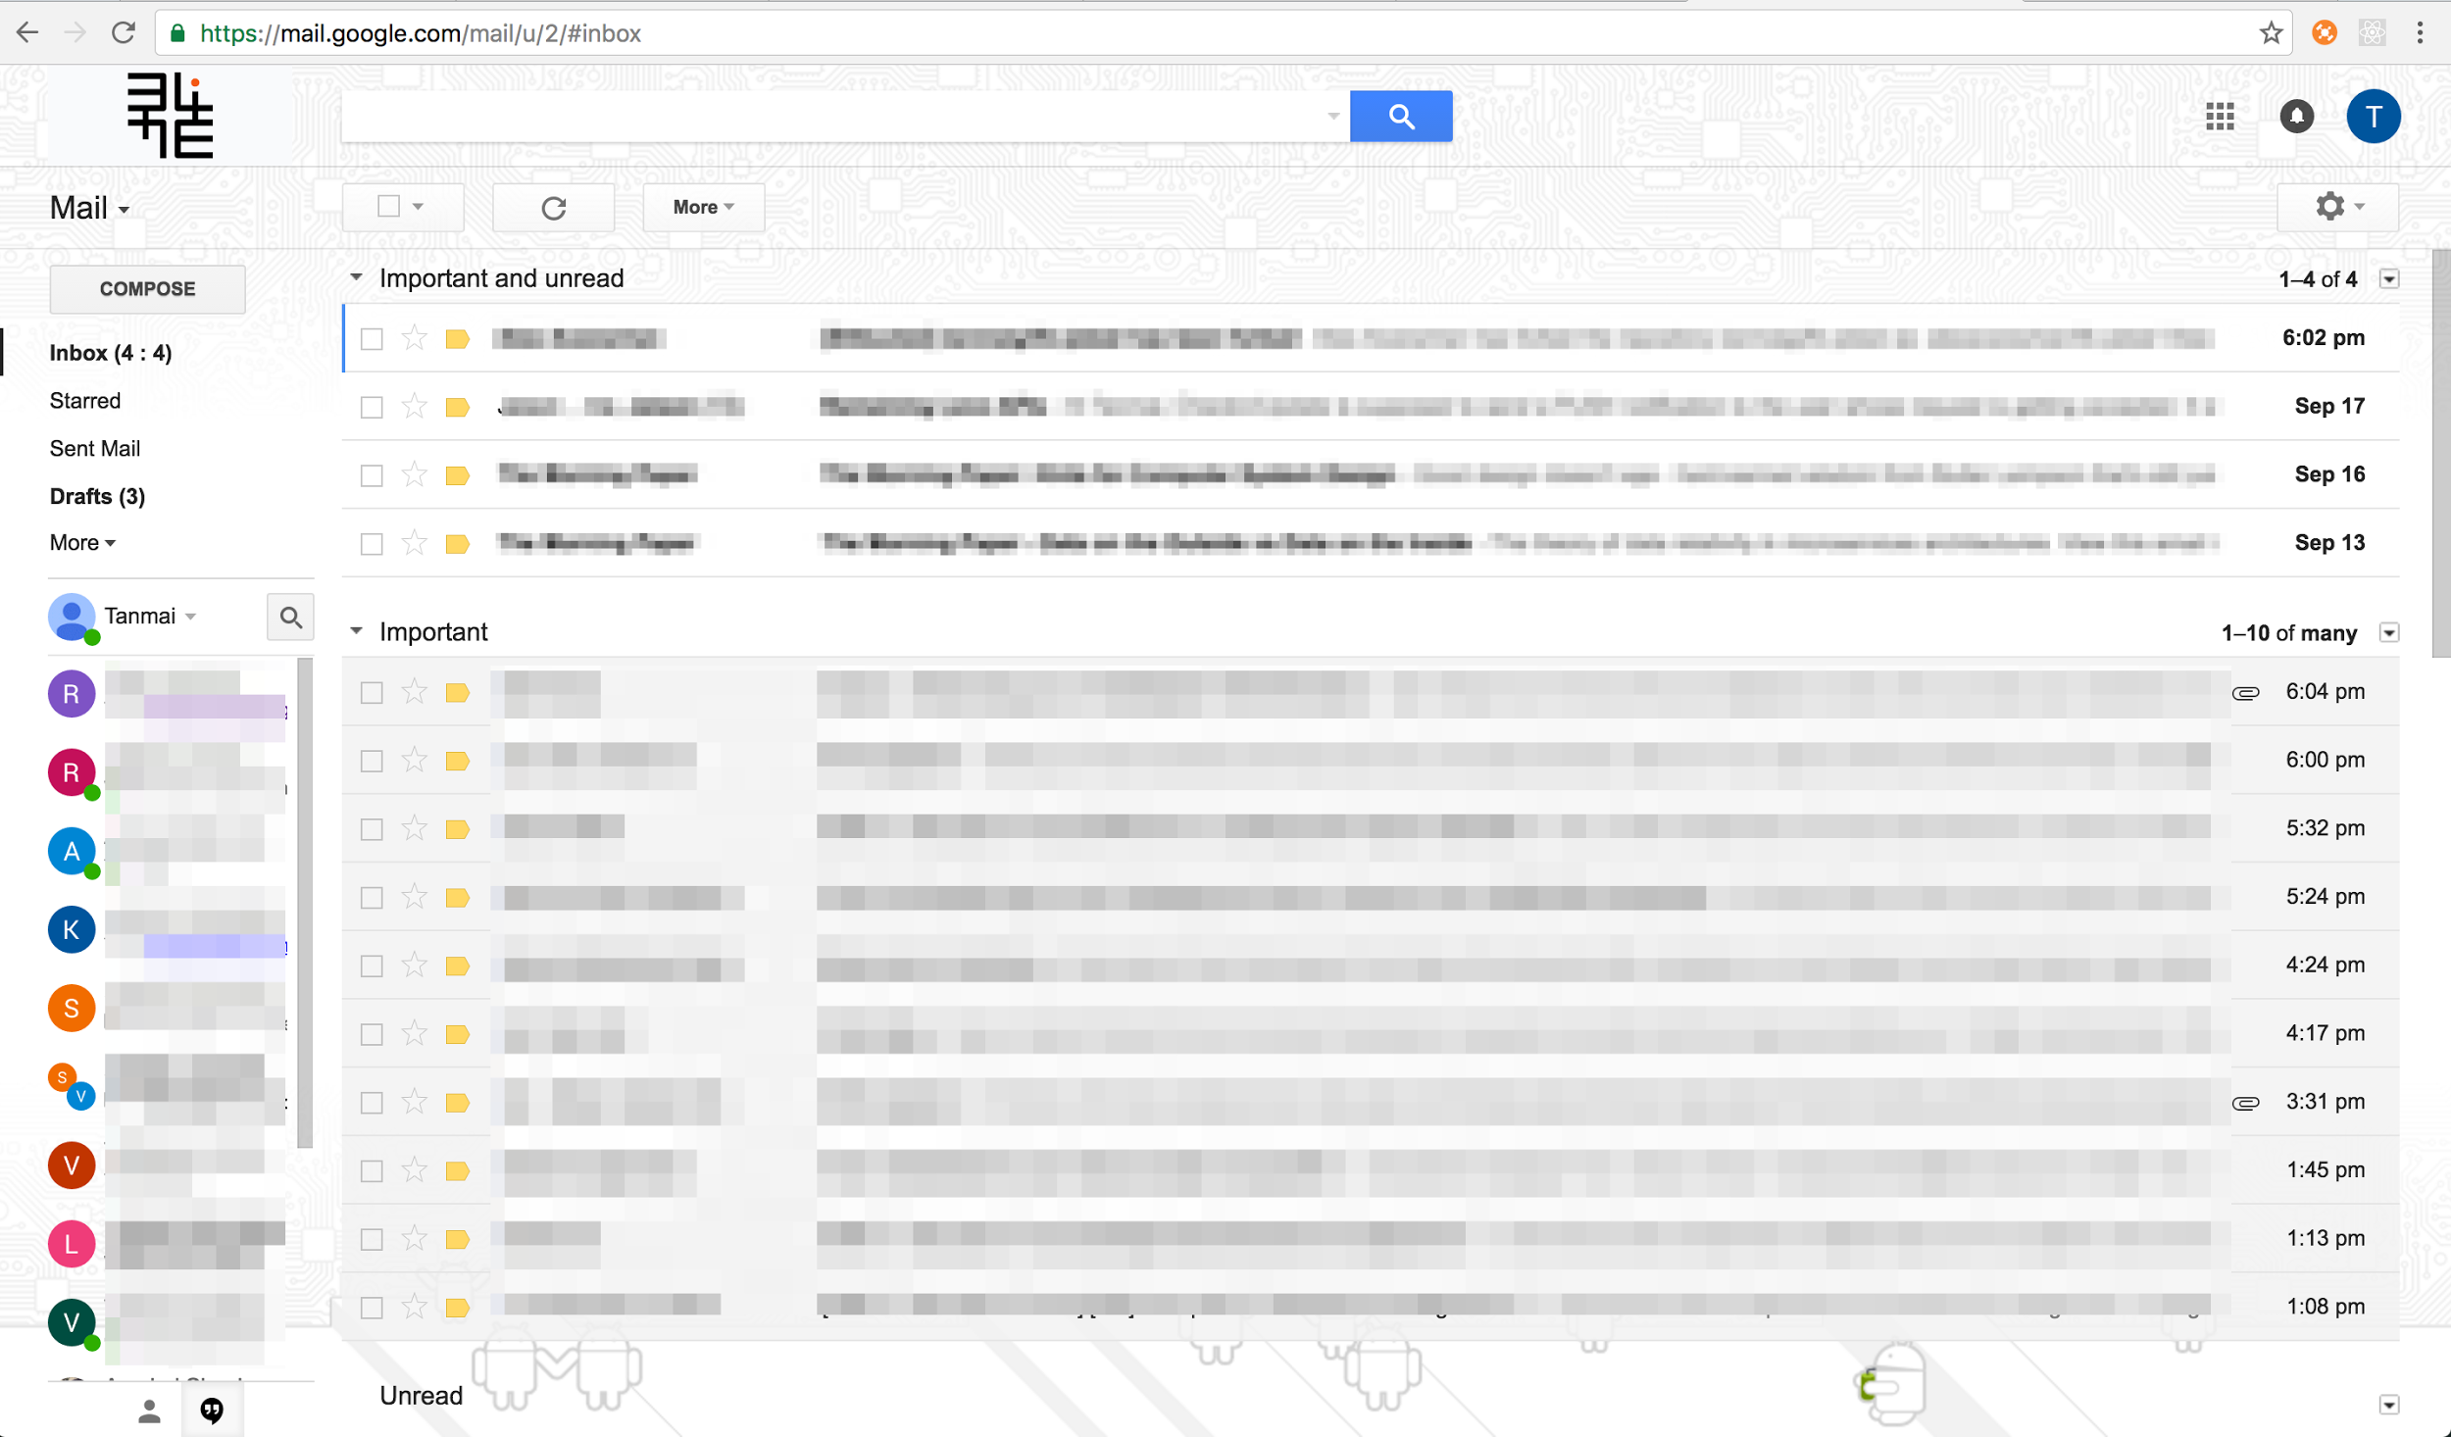
Separating code from data

Slide 7
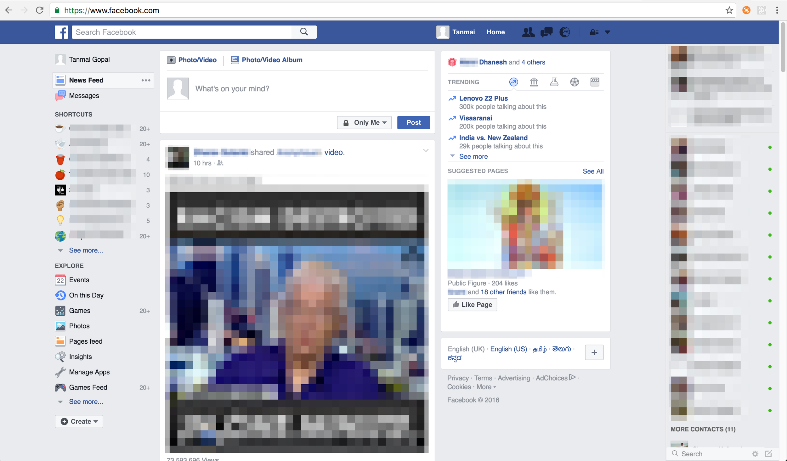
Separating code from data

Slide 8
Our current understanding of data
We covered 3 examples of using data:
Article templating
Counter incrementing
Adding to a names array

Slide 9
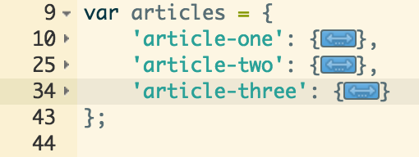
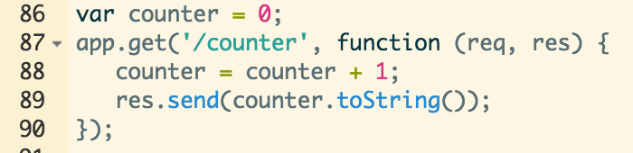
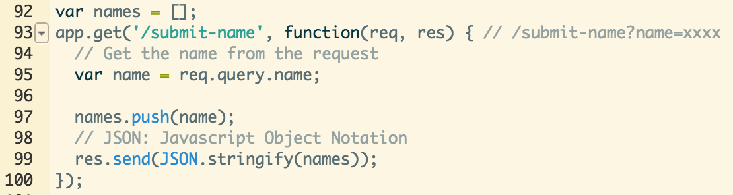
Our current understanding of data

Slide 10
Our current understanding of data
In all 3 examples, we stored the data as a data-structure in our code. However, some problems:
Article data was a part of the source code. What if we had 10,000 articles? What if it was more than a few GB? We can’t load that much as a part of our program source code! (RAM would be uselessly consumed)
Code maintenance and data maintenance are 2 separate problems which would get coupled
The counter and the names array is not persisted. Every single time the server restarts, we lose that information.

Slide 11
So. How do we solve this?
Extremely simple ideas!
Separate the data files from the code files and allow storage of large varying volumes of data
Load data on demand to reduce pressure on resources
Save data back to the data files as required

Slide 12
Implementation
We can implement a database ourselves.
Just store our data in separate files. Split them across multiple files if the files get too large. We can read the file to load data and save data.
But this will become a NIGHTMARE.
Think about writing code that does all these things:
Find data according to a particular property. Eg: All users with age greater than 21
Writing/updating data concurrently on the same file
Multiple people updating the same data. Eg: Wikipedia article being updated in parallel
Your server/hardware/OS crashes while you are writing information to the file
How would you secure access to these files?

Slide 13
Common problems should be solved once
In a high-performance and scalable way:
Storing data (knowledge of harddisks even!)
Querying data
Writing/updating data
Managing failure & corruption
This is why software to manage databases exist. One should almost NEVER EVER implement one’s own database.

Slide 14
Terminology
A database is a term that is used to refer to a collection of data. Excel sheets, a folder full of files, a CSV files are all databases.
In app development a database is commonly used to refer to a database managed by a specific software like SQLite, MySQL, Postgres or MongoDB. Databases can be created by server-side or client-side software.
These software that manage one or more databases for you are called DBMSs (DataBase Management Systems).

Slide 15
Using a database
We already understood that if we have data in the right data structures in our server side code, we can achieve whatever we want
Articles object
Counter integer
Names array
We now just need to get the right data into our data structures
Process:
Connect to the database
Whenever required, query from the database
Load the results into a data-structure that your server-side code can manipulate

Slide 16
Web Frameworks & ORMs
This process is also very common within the same web framework. So web-frameworks often come with tools to help you do this querying database, loading results business
For many frameworks, these tools fall in a category called ORMs (Object-Relational Mappings)

Slide 17
Backend architecture (before database)
Web server
Computer (server machine)

Slide 18
Backend architecture (with database)
Web server
DBMS
query
processing
response
request
Files
Disk
Computer (server machine)

Slide 19
Key takeaways
A database is a vital component of a modern app.
It is easy to separate portions of the app that should be a part of the application source code and portions of the app that should be maintained as data.
A database management system (the software that manages the database) should be used, as far as possible, instead of trying to handle data operations yourself
Modern DBMSs solve common problems across apps in a performant and efficient way
Storing high volumes of data, or rapidly growing data
Querying data
Managing concurrent access
Managing access control
Managing storage & recovery from failure and corruption

